Slide 1
B.Tech. Project
Analysis of lecture videos for indexing and retrieval
using Deep Learning
Presented by,
Siva Datta.B

Slide 2
Introduction
MOOCs like NPTEL have been producing quality educational content that is openly available for students for online consumption. Though the there is a whole lot of content available, it is difficult for students to navigate and to find a course suitable for them. It is not so easy to follow a particular professor whose teaching style suits the student better.And is also a struggle to find a particular topic.

Slide 3
Problem Statement
• Face V/s Slide Classification
• Title Extraction
• Facial Recognition

Slide 4
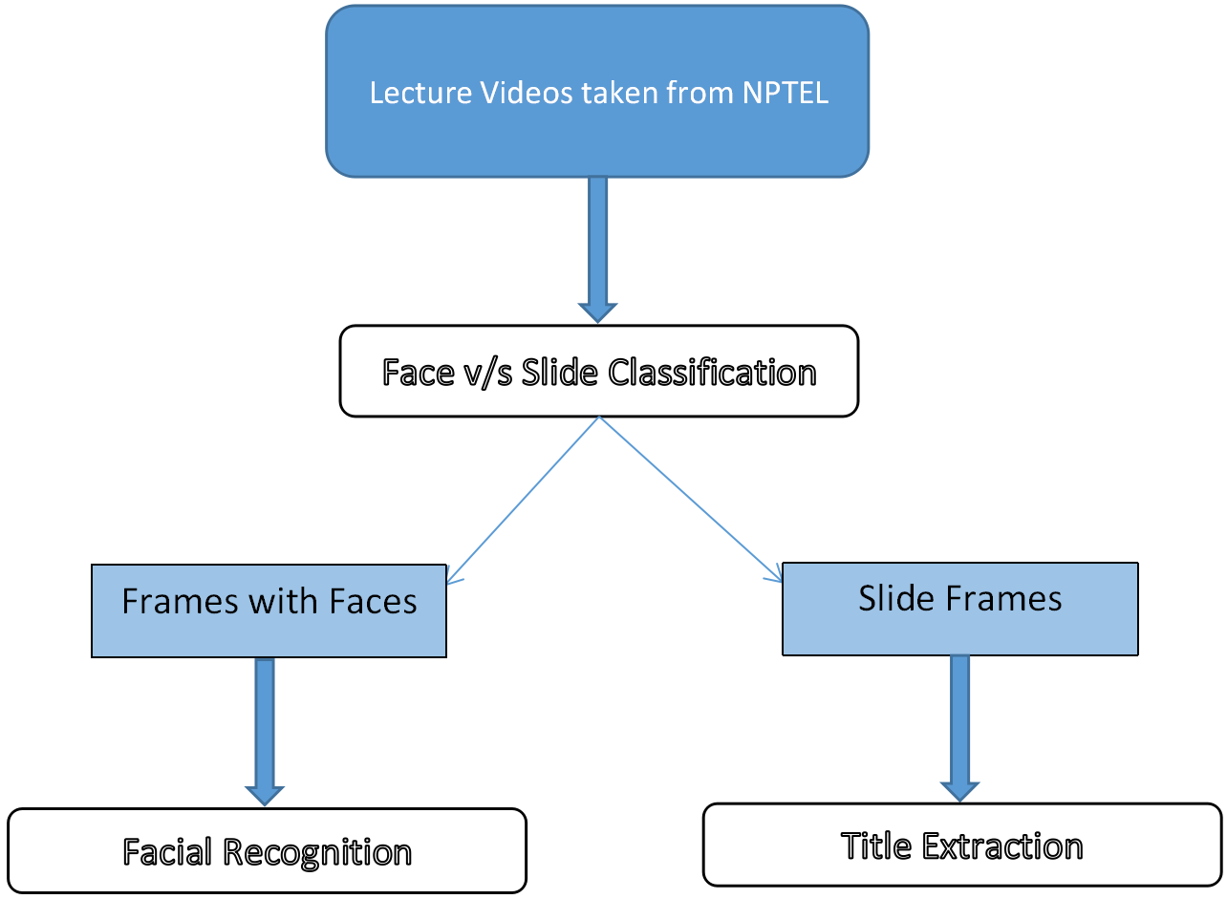
Problem Statement

Slide 5
Face V/s Slide Classification
Problem Statement
The first problem to be solved was to identify parts of the video which have slides in them.The frames containing slides will be used the ”Title Extraction” problem and the frames containing faces will be used for the ”Facial Recognition” problem.
Though this part will directly not solve any part of our main objective , this is the base for all the work and other parts will use the results obtained here.

Slide 6
Dataset Preparation
• Dataset to solve this problem contains images that were obtained by extracting frames from videos available on NPTEL website and hand picking them as unique as possible.
• Every video was converted into frames using ffmpeg open-source at a 0.5 frame rate per second and were carefully picked manually to avoid duplicates.
• Around 250 very unique images and 100 unique images for validation along with augmented data were used to train it for 20 epochs using a CNN.
• We made sure that the videos used for the data-set preparation were recorded by different content providers and had as different contrast and backgrounds as possible.

Slide 7
Features Extraction and pre-processing • Frames from each video tile have been extracted using ffmpeg open-source. All the images were resized to 64*64 irrespective of the video. • A simple normalisation of /255 was done as a preprocessing step and also generated augmented data using random zoom ranges from 0 to 0.2 and horizontal flipping before classifying into slide or face.

Slide 8
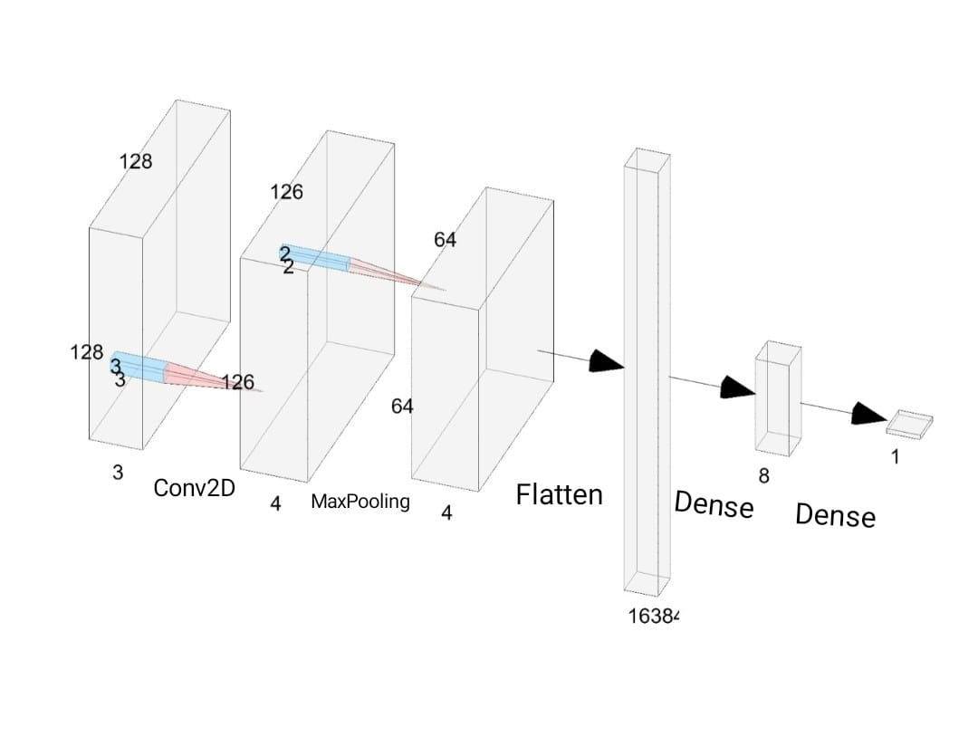
Solution Approach
• Other Parameters used : binary cross entropy loss was used to calculate the loss since this is binary classification problem along with the adam optimizer and monitored the accuracy metric to decide the optimal model.
• I applied this classifier over every 20th frame of the lecture videos and separated only the slides from lecture videos, the separated slides are then sent through title detection discussed below.

Slide 9
Title Extraction
Problem Statement
Now as we have the slides from the output of the previous problem,
our next target is to extract data from these slides. The title from each of these slides have to be extracted and these output titles help us in indexing the video.
The motivation behind this problem is that it takes a lot of time to search a particular topic in a series of lectures if videos alone are available. This approach helps us give out the main topics discussed in a lecture.

Slide 10
Dataset Preparation
• The dataset contained videos instead of images as it is more applicable to this
problem statement.
• We decided to use a completely different set of 75 videos of 30 seconds length,each
of which have been trimmed from videos of much larger length and have been taken
from NPTEL.
• We selected the videos such that the slides included in them have titles on top of
slides.

Slide 11
Features Extraction and pre-processing • The slides then extracted were converted to gray scale and the binary images using OTSU threshold. • The pytesseract OCR was then used extracted bounding boxes and text, which were used for the task.

Slide 12
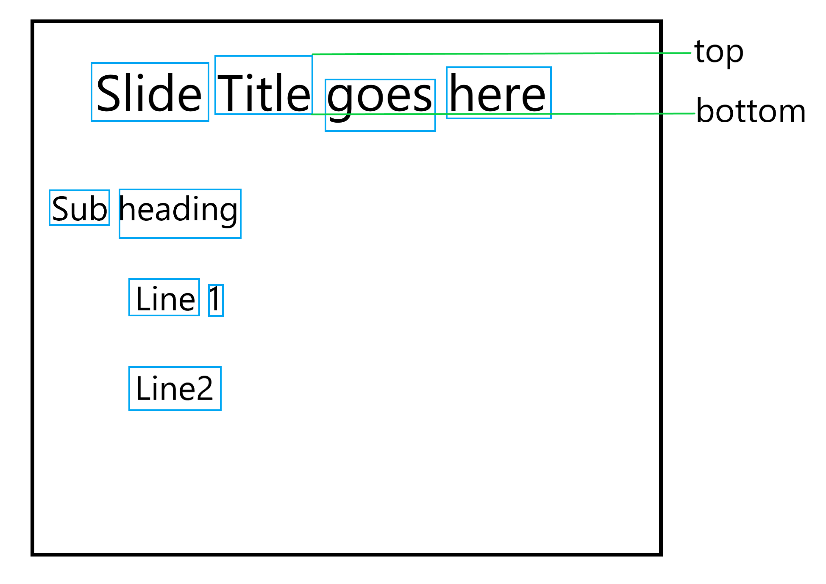
Solution Approach
• The idea is shown in the below image , where the blue boxes are the bounding boxes
we obtain as output by applying OCR over the slide.Here ”Slide Title Here” is our desired output.
• We first find the top most box from the OCR output , here it is ”Title”. We find top and bottom ends of that box as shown in the image above. We then select boxes that have an intersection with the area between top and bottom horizontal lines. The texts in these boxes make our title.

Slide 13
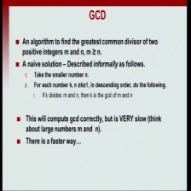
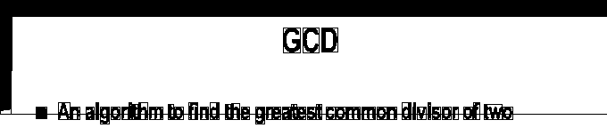
Demo
GCD

Slide 14
Facial Recognition
Problem Statement
This part deals with the courses as a whole rather than a particular video. We extract random frames from lecture videos present in various courses and group these courses based on the professor who teaches it, who is identified by using a facial recognition system.
This will be helpful to students who are aligned to a particular style of teaching and would be helped a lot by following the courses of a particular professor by maintaining continuity too.

Slide 15
Dataset Preparation
• Three different professors’ videos have been taken from the NPTEL website that were shot in different backgrounds and lighting conditions.
• FFmpeg open-source has been used to extract frames these videos and The frames containing faces have been extracted using the Face vs Slide Classifier.
• These faces extracted were ultimately given to MTCNN that detected faces and prepared a different data set that contained images of cropped faces of each professor.

Slide 16
Features Extraction and pre-processing • Cropped faces were send through the pre-trained model to extract features which here are the train and test embeddings. • Pre-processing step done here was to normalising the embeddings using the l2 norm and using a Label Encoder using scikit learn library before SVM prediction.

Slide 17
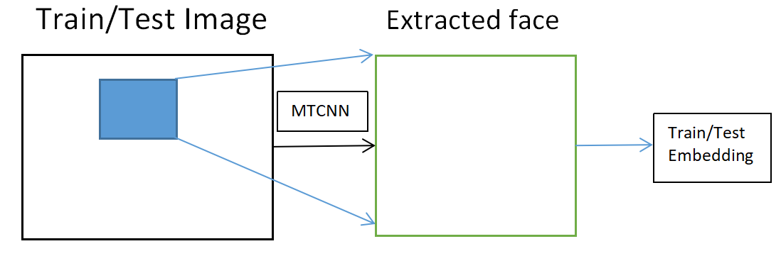
Solution Approach
Detection
• Used the Multi-Task Cascaded Convolutional Neural Network, or MTCNN, for face detection, for finding and extracting faces from photos. This is a state-of-the-art deep learning model for face detection, described in the 2016 paper titled “Joint Face Detection and Alignment Using Multitask Cascaded Convolutional Networks.”

Slide 18
Solution Approach
Recognition
After the faces are detected and cropped accordingly, a pre-trained FaceNet model will be used to create a face embedding for each detected face, then we train a Linear Support Vector Machine (SVM) classifier model to predict the identity of a given face.

Slide 19
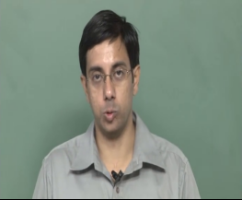
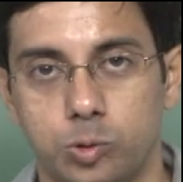
Demo
MTCNN
FaceNet
Label

Slide 20
Evaluation
• Videos having a single title of length 30 seconds that were taken from the videos available on NPTEL website were used to predict titles.
• Levenshtein distance was used to calculate the error between these. I used a set of 46 videos to calculate the accuracy of the algorithm and fixed various issues accordingly and achieved an accuracy of 0.88 on this set. The test set was then extended to 73 videos and achieved an accuracy of 0.84 with our algorithm.

Slide 21
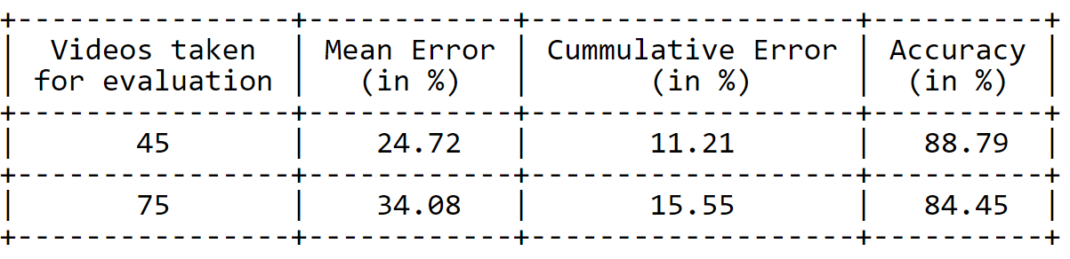
Evaluation
• Cumulative error shown below in the table is the weighted average over all the
errors in each video, where frequency of slides in each video is taken as weight for that particular video/title, while Mean Error does not consider that frequency.

Slide 22
Drawbacks and Challenges
• The major challenge faced was the unavailability of a ready data set and hence causing us to handpick the data set.
• Title Extraction was not giving the best results for the slides having a dark background and light text though the preprocessing step involves converting images into a binary image.
• The Title Extraction also does not work well in the cases where there are images at the top of those images.
• To cluster all the courses in NPTEL we need alot of data to process and train , since our computational power and storage capacity is limited, we considered only 3 professors as a sample data set.

Slide 23
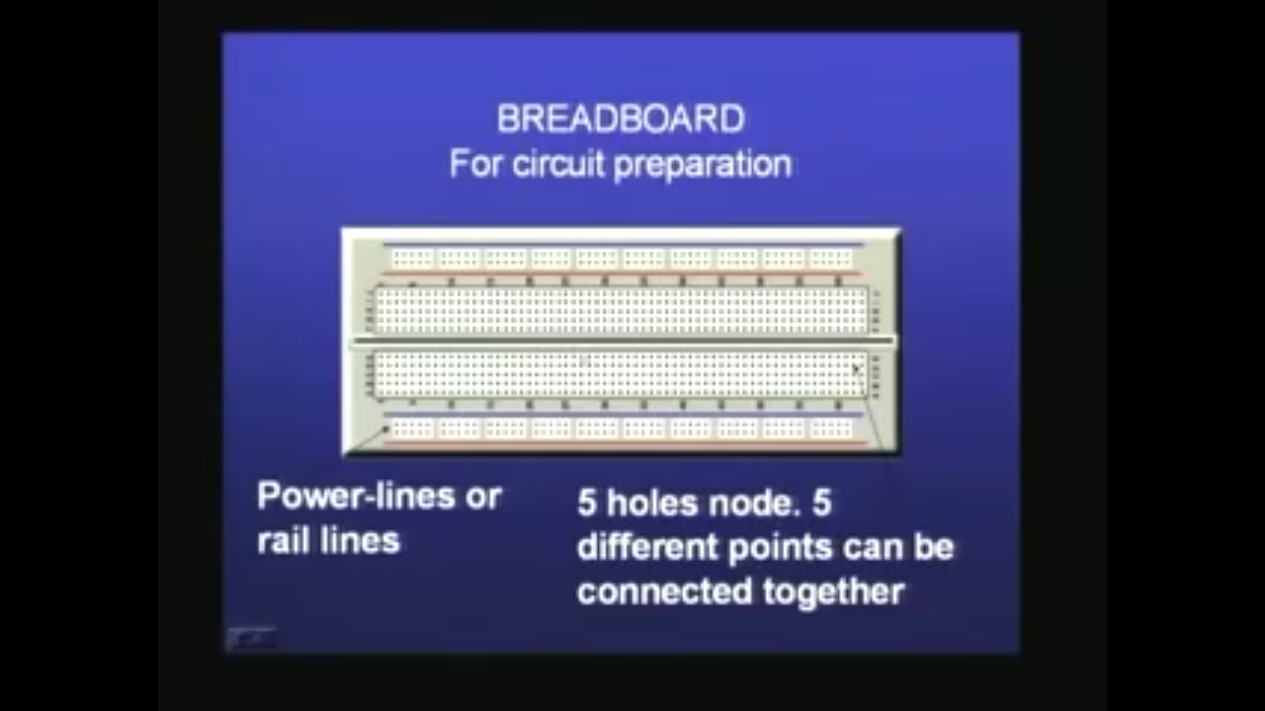
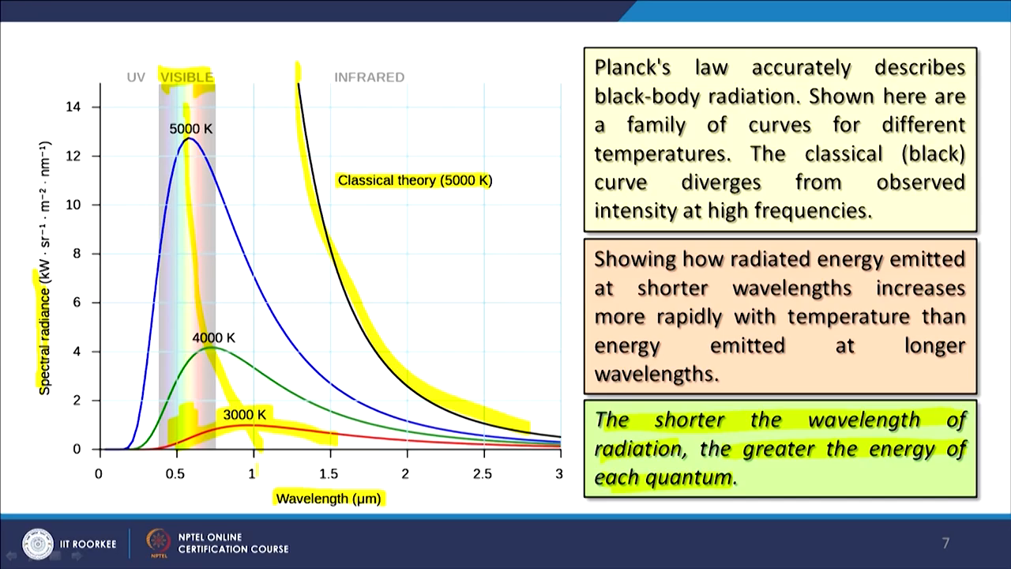
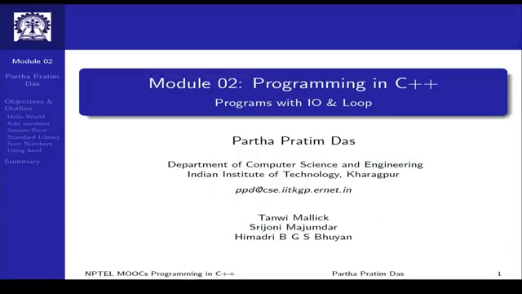
Drawbacks and Challenges
'brealboaro': 5, 'for preparation': 5, 'breadboaro': 25, 'breadboard': 3, 'for circutt preparation': 1, 'circutt preparation': 1, 'preparation': 1

Slide 24
Scope for Future work • Try fixing cases that give unpredictable outputs or random lines other than the title for Title Extraction task. • Increasing the accuracy of title prediction on slides that have a dark background and light text and Adding the possibility of extracting title from slides that have images above the title of the slide. • Computational Computation of Facial Recognition Model can be reduced over a lecture video by applying classification over a video rather than every frame individually. • The facial recognition model can further be tested by adding more faces to the database and generalising it better.

Slide 25
T
Thank you

Slide 26
References
[1] Sebastian Bock and Martin Weiß. “A Proof of Local Convergence for the Adam Optimizer”. In: July 2019, pp. 1–8. doi: 10.1109/IJCNN.2019.8852239.
[2] Rudrajit Das and Subhasis Chaudhuri. On the Separability of Classes with the CrossEntropy Loss Function. Sept. 2019.
[3] Theodoros Evgeniou and Massimiliano Pontil. “Support Vector Machines: Theory and Applications”. In: vol. 2049. Jan. 2001, pp. 249–257. doi: 10.1007/3-540-44673-7_12.
[4] Theodoros Evgeniou and Massimiliano Pontil. “Support Vector Machines: Theory and Applications”. In: vol. 2049. Jan. 2001, pp. 249–257. doi: 10.1007/3-540-44673-7_12.

Slide 27
References
[5] Hongchang Ku and Wei Dong. “Face Recognition Based on MTCNN and Convolutional Neural Network”. In: Frontiers in Signal Processing 4 (Jan. 2020). doi: 10.22606/fsp. 2020.41006.
[6] Keiron O’Shea and Ryan Nash. “An Introduction to Convolutional Neural Networks”. In: ArXiv e-prints (Nov. 2015).
[7] M. A. Rahiman and M. S. Rajasree. “A Detailed Study and Analysis of OCR Research in South Indian Scripts”. In: 2009 International Conference on Advances in Recent Technologies in Communication and Computing. 2009, pp. 31–38. doi: 10.1109/ARTCom.2009.45.
[8] Saad Albawi; Tareq Abed Mohammed; Saad Al-Zawi. “Understanding of a convolutional neural network”. In: International Conference on Engineering and Technology (ICET)(2017).

